Slide 1

Hand-drawn Flowchart Template To Digital Flowchart
Abdulrahman Elgendy 400051947
Notes:
Hi my name Abdul, and today I will be presenting my 4TN4 project. The main idea of my project is to convert a hand-drawn flowchart template to a digital version.

Slide 2
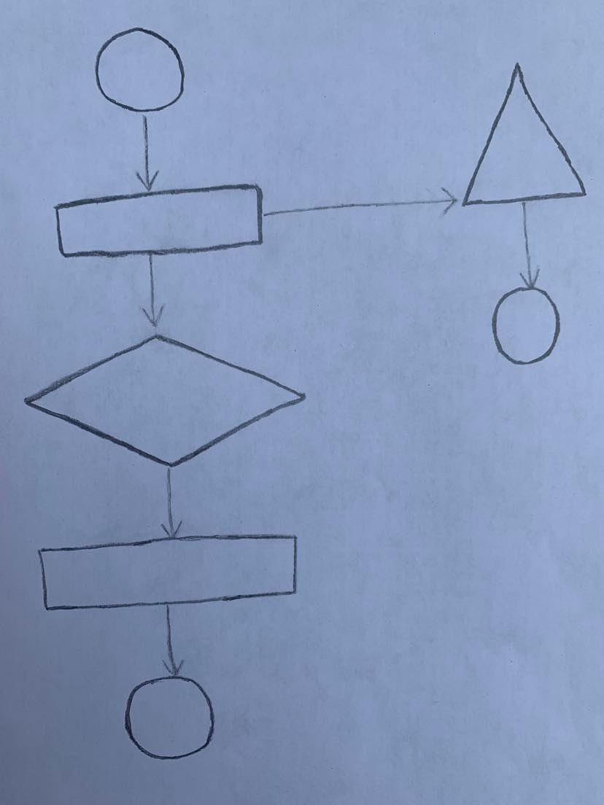
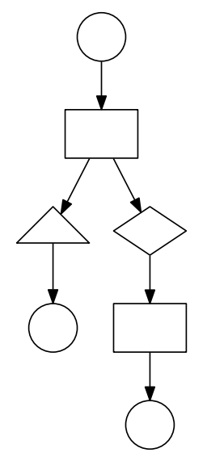
Introduction
Goal of the project is to transform a hand-drawn flowchart template to an editable digital version
Benefits:
minimize the time spent creating a digital flowchart
Notes:
Flowcharts are a very popular tool with a variety of applications, and they're mainly used to describe a process. Now, Many people are more comfortable creating hand-draw flowcharts because they are quicker and more convenient to create compared with creating a digital version using a software tool. Therefore, the aim of this project is to bridge the gap and allow the user to quickly sketch the flowchart template that they would like to use and then take a picture of the flowchart and pass it through an application that will create a digital version of the flowchart that the user can edit right away.

Slide 3
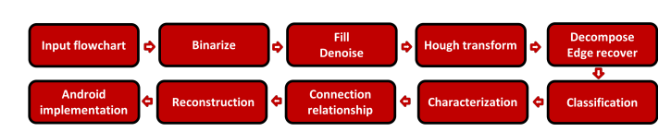
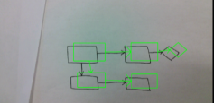
Related Works
[1] Tries to predict the geometrical shapes of the flowchart components using area of the shape relative to the area of the bounding box.
Disadvantages:
hand-written shapes are drawn slightly differently by different people, so using single ratio cannot be robust enough to classify accurately
[1] Qian Yu, Rao Zhang, Tien-Ning Hsu, Zheng Lyu, "Your Flowchart Secretary: Real-Time Hand-Written Flowchart Converter" ,2020.
Notes:
To look at some related works, I will be looking at the methodology proposed by Qian Yu at Stanford University, which converts a flowchart template to a digital one in real-time.
The outline of the methodology can be seen in the figure below. It first starts with some pre-processing steps and then is followed by a shapes classification step, and they predict the geometrical shapes of the flowchart components using area of the shape relative to the area of the bounding box. Finally, the last steps in their methodology involves finding a relationship between the shapes and arrows and then reconstructing the flowchart digitally.
The main disadvantage of the described shape classifier is that hand-written shapes are drawn slightly differently by different people, so there is an element of variability in the way that people draw shapes. Therefore, a single ratio would not be sufficient to have a robust classifier. Therefore, this project will aim at improving the classification and pre-processing steps suggested in the paper.

Slide 4
Proposed Methodology
Figure below illustrates the outline of steps taken to achieve the objectives of this project given the assumptions mentioned above.
Input flowchart
Binarize flowchart
Find flowchart components
Decompose components to shapes and arrows
Classification of shapes and arrows
Flowchart reconstruction
Output digital image
Assumptions:
Classified shapes will be restricted to hand-drawn rectangles, diamonds, circles, and triangles.
The arrows in the flowchart should always be straight.
There should be no intersections among arrows.
This project focuses solely on creating a digital template. Therefore, all input flowcharts should not be filled with words.
Notes:
My proposed methodology can be seen in this diagram. Firstly, the image would be binarized and then the shapes and arrows would be found and isolated. After that the shapes are separated from the arrows for further analysis. After the shapes will be classified through a trained SVM model and the arrows will be analyzed to match them to their respective shapes, and finally the flowchart is reconstructed digitally.
To make this project achievable as a course project, the following assumptions will be made:
Classified shapes will be restricted to hand-drawn rectangles, diamonds, circles, and triangles.
The arrows in the flowchart should always be straight.
There should be no intersections among arrows.
This project focuses solely on creating a digital template. Therefore, all input flowcharts should not be filled with words.

Slide 5
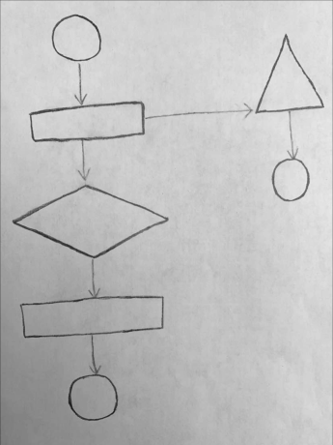
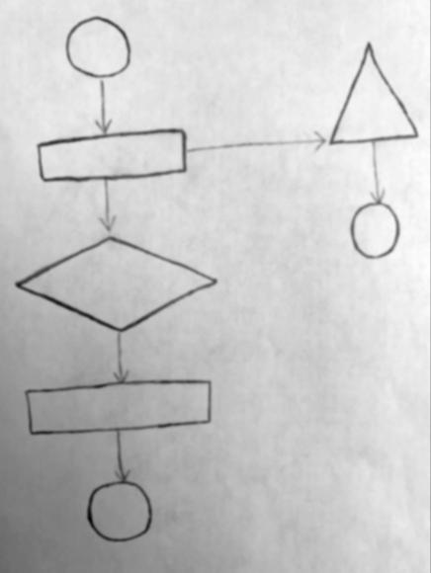
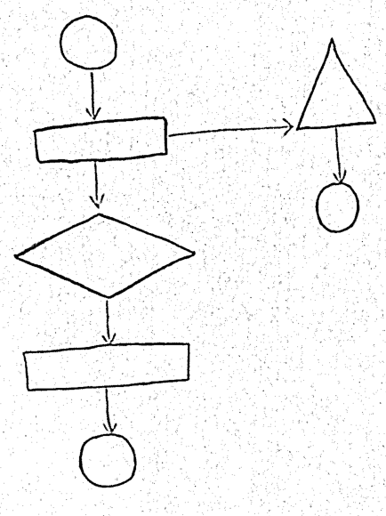
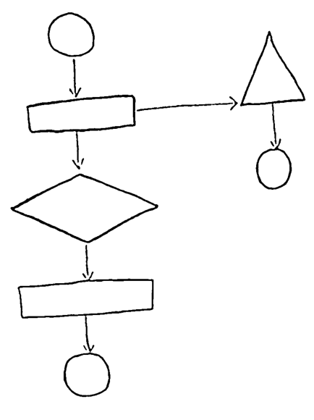
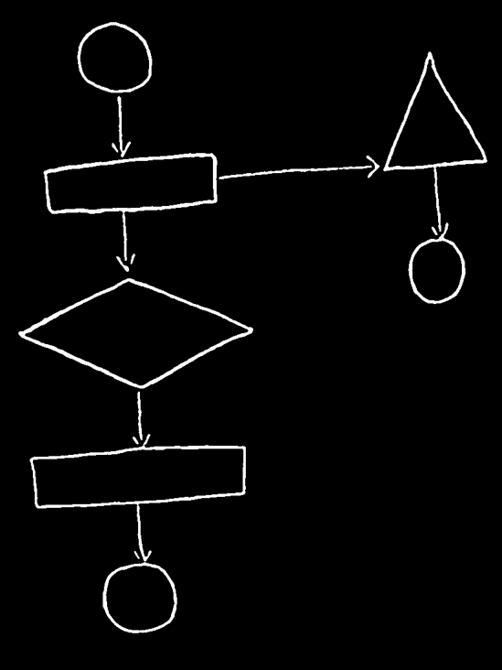
Binarize Flowchart
BGR to Grayscale conversion
Blurring using gaussian filter
Adaptive thresholding to turn it to a binary image
Median filter to remove pepper noise
Bitwise inversion to swap foreground and background
BGR
Gray
Gauss
Adaptive thresh
Median
inverted
Notes:
This first step involves creating a binary image of the flowchart. This important as it will make the process of separating the flowchart components from the background an easier task. To do this, the image is first converted to gray-scale and then the image is blurred using a gaussian filter,
After that a thresholding technique will have to be considered to turn it into a binary image. Due to the shadows that might be present on the flowchart image and the varying contrast levels across different parts of the image, a global thresholding technique will not work well. Therefore, I chose adaptive thresholding for this application. After adaptive thresholding, there might be some pepper noise left on the binary image and to remove that, I used a median filter. The final step is to do a bit-wise inversion of the binary image.

Slide 6
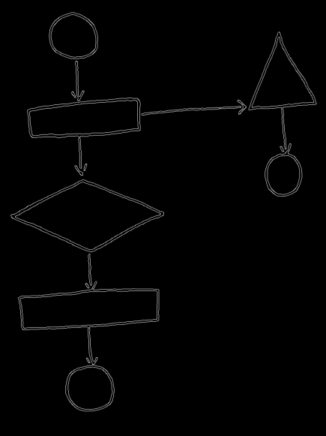
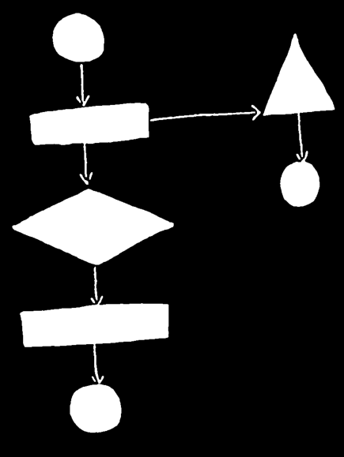
Find Flowchart Components
Find edges using Canny operator
Find contours and fill them all with white to create a connected component
Canny
Filled Contours
Notes:
To find the flowchart components, I start by finding the edges using the canny operator. After extracting the edges, I found the contours of the image and filled all the contours with white. This will create a set of connected components and will provide a clear separation between the flowchart and the background.

Slide 7
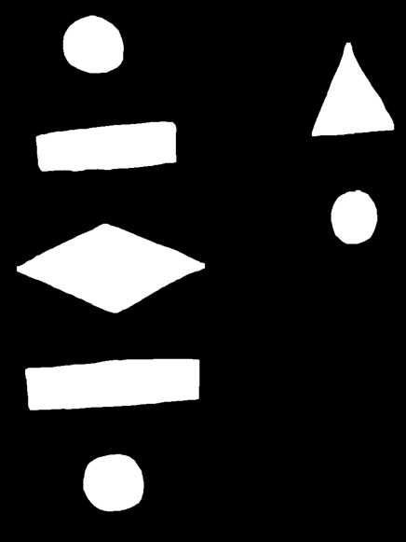
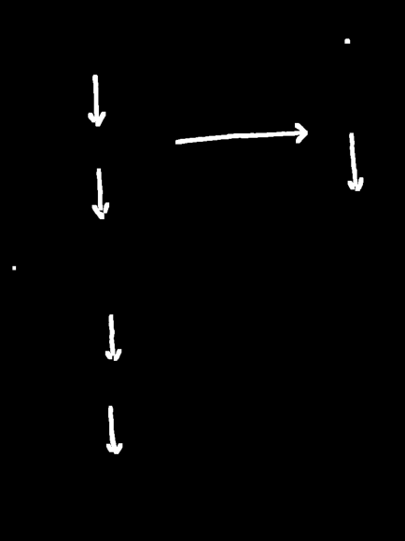
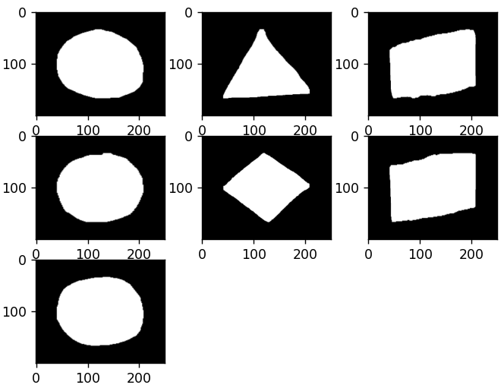
Decompose Flowchart Components
Decompose flowchart to isolated shapes and arrows
Morphological opening to remove arrows and keep shapes only
Subtract shapes only image from original image to get arrows only image
Dilate arrows image to fill any holes In the arrows
Extract regions of interest for every shape to prepare for feature extraction & classification
Morph Opening
Dilated Arrows
Shapes ROIs
Notes:
The next step is decomposing the flowchart into shapes and arrows. The arrows can be thought of as thin bridges connecting the different flowchart shapes to each other. Therefore, morphological opening will be used to remove the arrows and isolate the shapes. Now that I have the isolated shapes, I subtracted the isolated shapes from the original image to get an image containing the arrows only. Due to the arrows being very thin, I dilated the arrows to make sure that all the holes in the arrows are covered.
The shapes are then decomposed further and by creating a region of interest for every shape. To create these regions of interest, I found the contour for every shape in the image and created a bounding box for every shape. After that, the area covered by the bounding box is extracted and a padding of black pixels is added to the top, bottom, left, right of that bounding box so that the contour for the shape is clearly visible. Feature extraction will be done on those images and to maintain uniformity across the different shapes I need to make sure that all the regions of interest are of the same size. Therefore, the regions of interest are resized to 250x200 before extracting feature vectors.

Slide 8
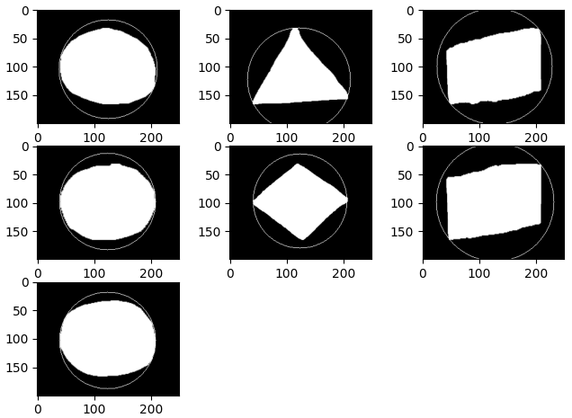
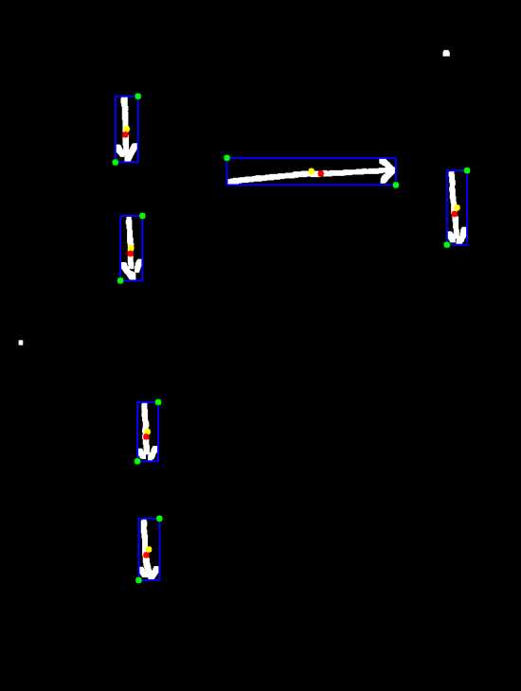
Feature Extraction
Shapes Features Extraction
Feature vector made up of HoG descriptor and (area of shape / area of minimum enclosing circle)
Arrows Feature Extraction
Interested in extracting an approximation of the coordinate of the head of the arrow and an approximation of the coordinate of the tail of the arrow
Min Enclosing Circle
Arrows Features
Notes:
The outlines of geometric shapes used in flowcharts are highly differentiable ,so HoG descriptors would be able to capture such outline information. Therefore, the HoG descriptor will make up the first part of the feature vector. More representative features could also be added to the feature vector. If I find the minimum enclosing circle for every shape, I can find the ratio of the (area of shape contour / area of minimum enclosing circle). This ratio would be different for different shapes. For example, for circular shapes, this ratio would be closer to one, whereas for a triangle shape, the ratio would be a lot less that that, and this feature is also added to the feature vector.
For the arrows, the main features that I’m interested in is an approximation of the coordinate of the head of the arrows and an approximation of the coordinate of the tails of the arrow. I first need to find all the connected components in the image , and then filter out the connected components that may be noise and are too small to be arrows. For the remaining connected components, I need to create a bounding box, and then find the centroid of every arrow which is the red dots in the image. By looking at the general structure of an arrow, I can assume that the centroid is always closer to the head of the arrow compared to the tail of the arrow. Therefore, to approximate the coordinate of the head of the arrow, I found the bounding box corner point that is closest to the centroid. The corner point diagonal to that chosen corner point can be used to approximate the coordinate of the tail of the arrow, and these points are the green dots in the image.

Slide 9
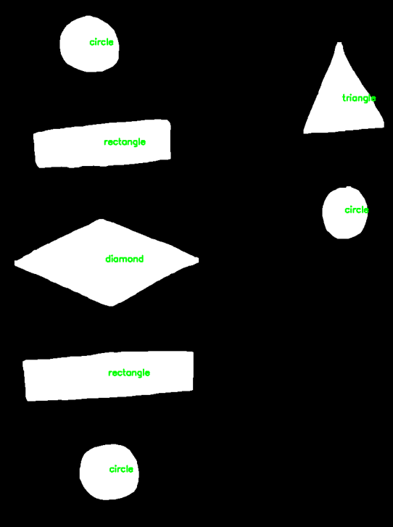
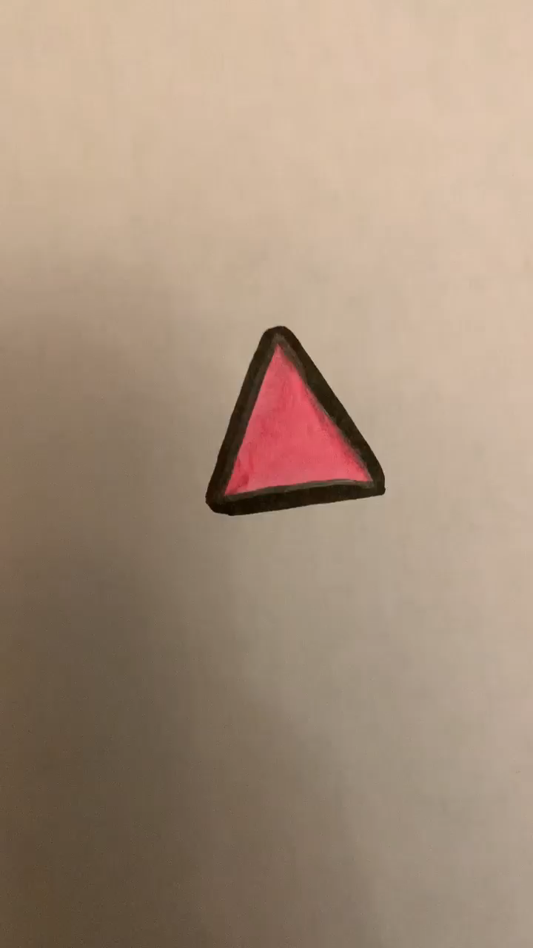

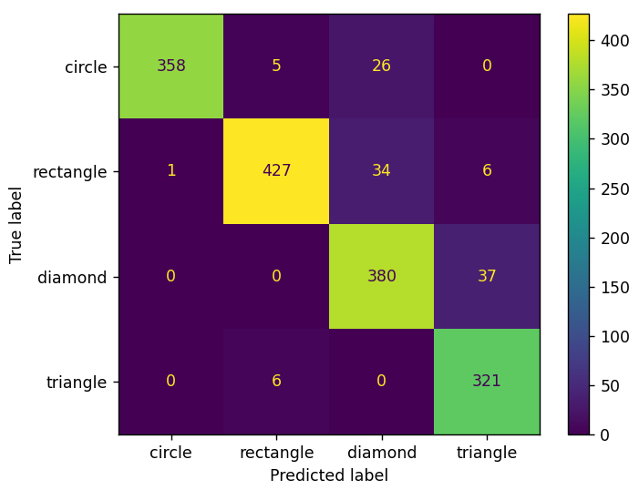
Shape Classification
Dataset Creation
Created my own dataset of 6,782 images of hand-drawn geometric shapes for training and 1,601 for testing purposes
Classifier:
SVM model trained on the feature vector described in the previous slide using the newly created dataset
Confusion Matrix generated on the dataset
Data-processing
Confusion Matrix
Dataset Collection
Classification Results
Notes:
To do shape classification, I will be training an SVM model. Since there is a clear margin of separation between the shapes classes, SVM would work relatively well. When looking for datasets, I was only able to find datasets of synthetically generated shapes., but the reality about hand-drawn shapes is that its very difficult to draw a perfectly symmetrical shape, and different people would draw the same shape in slightly different ways. Therefore, I decided to create my own dataset of hand-drawn shapes containing circles, diamonds, rectangles, and triangles. The dataset was gathered by asking five people to draw the four required shapes on a piece of paper. The drawn shapes were then filled with a distinctive color (pink) so that the shapes can easily be extracted when processing the data. After that, a video recording is started on every drawn shape, where the camera is kept static, and the paper is rotated so that the camera captures the shape at different orientations. These videos are all collected, and their frames are pre-processed and added to the dataset.
The pre-processing involves converting the image to the HSV colour space and doing thresholding on the Hue channel to filter out any colours that are not pink. After that the image is binarized and contour of the image is found and processed to produce the image seen here which is added to the dataset. I was able to create a training set consisting of 6,786 images and a testing set consisting of 1,600 images. To create the test set, I asked five different people to draw the four required shapes on a piece of paper, and the same data processing procedure is done. The results of testing my trained model on the test set can be seen in the confusion matrix. As you can see, the model is performing well as most predictions are along the diagonal and the weighted average precision and recall are both 93%. The classification results on the sample image can also be seen on the image to the right and all shapes were predicted correctly..

Slide 10
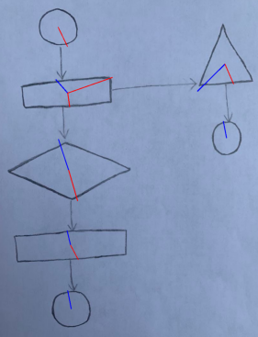
Flowchart Reconstruction
Find source and destination of every arrow:
The shape with the shortest distance to the tail of the arrow is the source of the arrow.
The shape with the shortest distance to the head of the arrow is the destination of the arrow.
Classified Shapes
Arrows Features
Arrow Connections
Notes:
After classifying the shapes, and extracting the necessary information about the arrows, the next step would involve linking the arrows to their respective shapes.
To do that, I need to find the shape that is the source of the arrow and the shape that is the destination of the arrow. To find the source of the arrow, I calculated the distance between the coordinate of the tail of the arrow and the centroid of all the shapes. The shape with the shortest distance to the tail of the arrow is the source of the arrow. The same logic is applied to finding the destination of the arrow. I calculate the distance between the coordinate of the head of the arrow and the centroid of all the shapes. The shape with the shortest distance to the head of the arrow is the destination of the arrow. The image on the right visualizes the output of this process. The red lines represent an arrow leaving the source shape, and the blue lines represent an arrow reaching the destination shape. As you can see, for every arrow, there is a red line behind it and a blue line in front it.

Slide 11
Final Result
Python library called Flowgiston which is used for easy flowchart development in Python.
Reconstructed Flowchart
Notes:
Finally, to reconstruct the template, I used a python library called Flowgiston which is used for easy flowchart development in Python. I wrote a supporting class that takes in the classified shapes and their arrow relationships and does the required function calls in the Flowgiston library to construct the desired flowchart. The resulting reconstructed flowchart can be seen here. The position of the arrows and shapes may not be the same as the original flowchart, but the direction of the flow and arrows is correct.

Slide 12
References
[1] Qian Yu, Rao Zhang, Tien-Ning Hsu, Zheng Lyu, "Your Flowchart Secretary: Real-Time Hand-Written Flowchart Converter" ,2020.
[2] S. Chakraborty, S. Paul and S. M. Masudul Ahsan, "A Novel Approach to Rapidly Generate Document from Hand Drawn Flowcharts," 2020 IEEE Region 10 Symposium (TENSYMP), 2020, pp. 702-705, doi: 10.1109/TENSYMP50017.2020.9231033.
Notes:
To conclude, this paper has successfully produced a robust methodology to recognize hand-drawn flowchart templates and transform them to digital versions. For future work, the proposed methodology can be improved by using a CNN and adding more complex shapes to the training set.

